Slide 1
Current Graphics Outputs for Text Analysis
Word Counting Tools Specifically
June 2017, D. Graham Andrews

Slide 2
Audience and Purpose
Audience: Managers and new users
This slide deck is aimed at people who want to understand what this toolset does without knowing exactly how to use it.

Slide 3
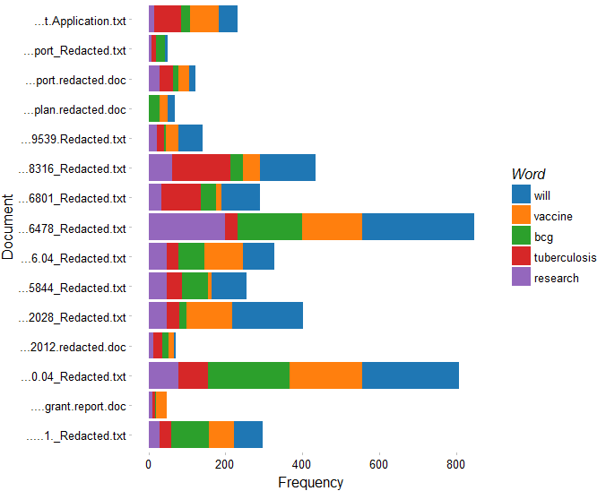
Plotting the five most common words across many documents:
Notes:
wfplots(tdm2,wordcount=5,shortendoc = T, typePlot=2)

Slide 4
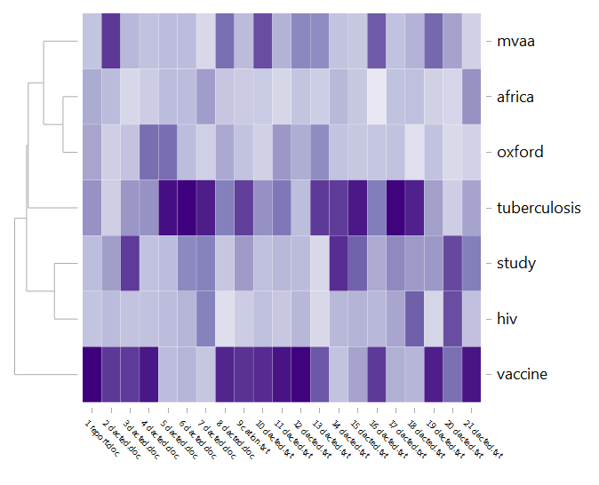
Plotting the density of chosen words across many documents:
Notes:
word_heatmap(tdm2,10,minfreq=2, dendrows = T, dendcolumns = F, pickwords = c("tuberculosis","vaccine","africa","oxford","mvaa","study","hiv"))

Slide 5
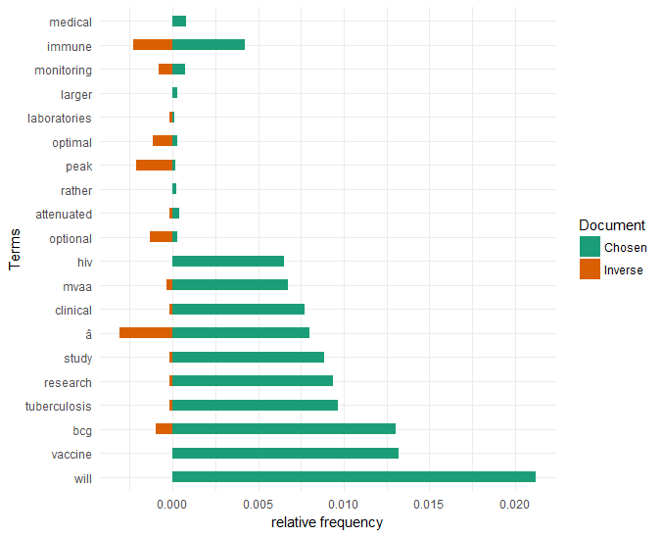
Relative frequency of other words given the presence of “BCG”
Notes:
tornadoCompare(tdm2,"bcg",frequency=5,nwords=10)

Slide 6
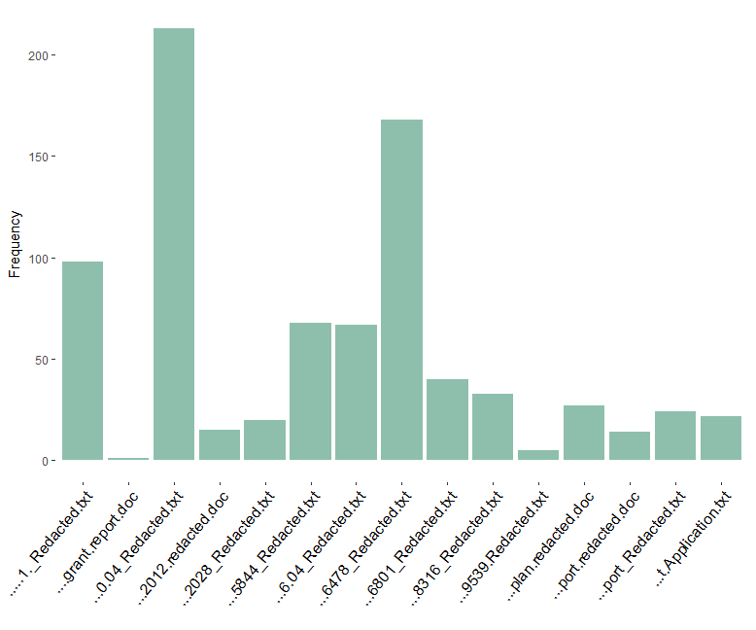
Single word frequency charts, ex: “BCG”
Notes:
interest_plot_bydoc("bcg",tdm2)

Slide 7
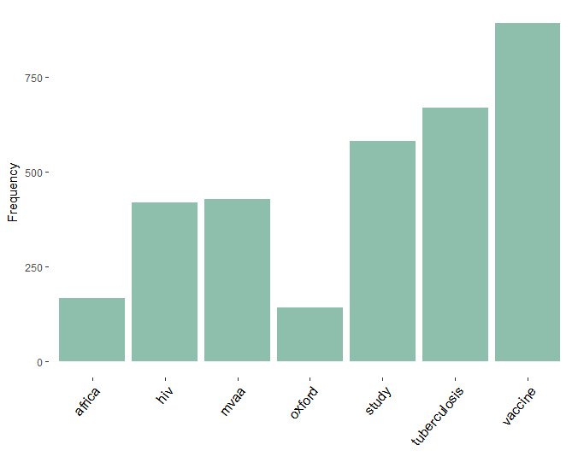
Multiple word frequency charts across all documents
Notes:
interest_plot(“bcg",TermDocumentMatrix(corpus1),by.var=variable,“year")

Slide 8
Some Visualizations are more for Research than display…

Slide 9
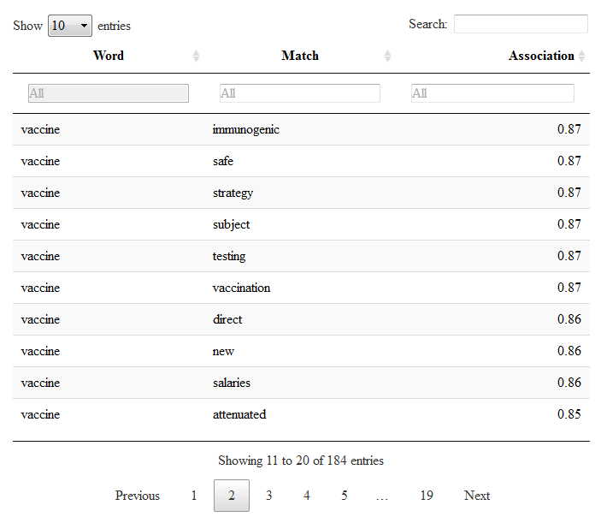
Associating words with other words
Notes:
assocPrettyOneStep("vaccine",tdm2, wellcome_corpus_clean2,.7)

